Slide 1




MALAYSIA: RECENT MONITORING AND ASSESSMENT EXERCISES
Department of Statistics Malaysia
Workshop on the Operation of Civil registration, Vital Statistics and Identity Management Systems for East Asian Countries
13- 17 November 2017
Hanoi, Vietnam
Mohd Sofi Bin Ali
Principal Asst. Director
Pop. & Demographic Statistics Division
Department of Statistics Malaysia
JABATAN PERANGKAAN MALAYSIA
https://www.dosm.gov.my
https://www.facebook.com/StatsMalaysia
https://twitter.com/StatsMalaysia
Notes:
Thank you Madame Chair. First of all, I would like to congratulate UNSD and other partners for organising a very fruitful workshop and many thanks also for inviting us to join this workshop. My name is Mohd Sofi Ali and i’m from Department of Statistics, Malaysia.

Slide 2
Outline
Introduction
Mechanism in the production of Vital Statistics for Malaysia
Quality Assessments Method
Issues and challenges
JABATAN PERANGKAAN MALAYSIA
https://www.dosm.gov.my
https://www.facebook.com/StatsMalaysia
https://twitter.com/StatsMalaysia
Notes:
This is the outline of my presentation today. We will start a little bit on the introduction basically on demographic indicators, then will look into the mechanism in the production of VS, Malaysia. After that, I will briefly talk about quality assessment method and finally about issues and challenges for our country.

Slide 3



Introduction
Malaysia Demographic Transition
1st Phase
2nd Phase
3rd Phase
Population 2017: 32.0 mil.
CBR 1957: 46.2
CDR 1921: 28.5
CBR 1921: 27.2
CBR 2017: 16.1
CDR 1957: 12.4
CDR 2017: 5.2
Population 1921: 2.9 mil.
Population 1957: 6.3 mil.
JABATAN PERANGKAAN MALAYSIA
https://www.dosm.gov.my
https://www.facebook.com/StatsMalaysia
https://twitter.com/StatsMalaysia
Notes:
This is the most beautiful demographics graph for Malaysia. This charts was very much useful for our stakeholders, planners and policy makers.
From this graph, we can see that Malaysia has gone through a third phase where the first phase occurred between 1911-1921 and the CDR at this time was higher than CBR. Then in the second phase of 1922-1957, Malaysia showed a positive development when the rate of birth increased with a decrease in mortality rate.
Furthermore, in the third phase, the rate of birth began to decline with the mortality rate began to stabilize and plateu. In addition, Malaysia's TFR in 2017 is 1.9 children in and was below of the replacement level (2.1).
Data tells you what’s happening. Stories tell you why it matters.

Slide 4
Introduction
Improvements on Vital Statistics of Malaysia
Reduce time lapse in producing VS from 2 years to 1 year;
Introducing info graphic for dissemination; and
Data received in monthly basis and via file transfer protocol (ftp).
2017
1. Data adjustment due to under reporting of death in Sabah.
2016
2014-2015
2012-2013
1. Free downloadable publications at DOSM portal.
Small area statistics (rate by a.d);
Reduce time lapse in producing COD statistics from 2 years to 1 year;
Data harmonisation with MoH (maternal & U5 death, stillbirth).
2010-2011
2000-2001
1. Data harmonisation with MoH (maternal & U5);
2. Malaysia has adopted the resolutions of Ministerial Declaration to ‘Get Everyone in The Picture’ and RAF.
CRVS Digitisation- Civil registration system;
DOSM received vital event data in softcopy format.
Notes:
I would like to also draw attention to the improvement activities undertaken either by DOSM or collaboration between with other agencies such as NRD, MoH in producing accurate, reliable and timely Statistical Vital publications.
Starting from 2000 to 2001..

Slide 5
Mechanism in the production of Vital Statistics for Malaysia
WORK FLOW FOR VITAL STATISTICS COMPILATION
START
Query to NRD
Receive
Records
Receive of records on births, deaths and stillbirths from the National Registration Department (NRD) in softcopy format at monthly basis (ftp). Compatibility between NRD and DOSM System
Preliminary
Checking
2. Checking the number of records received against attached summary
3. Checking partial information (including unknown) and remove duplicates – check id (identification cards number) against previous files.
No
Correct ?
Yes
4. Coding of sex, ethnicity, citizenship and state particulars
5. Coding of localities ‘Usual Place of Residence’ (address) particulars (manual and automated)
Coding of Causes of Death (detailed – 3 digits ICD-10) – manual and automated
  Coding
Checking
7. Verify the codes by supervisor
No
Correct ?
Yes
Note
ICD – International Statistical Classification of Diseases and Related Health Problems
A
Notes:
So, what is the factor that resulting in what I present in the last two slaid.. Let us to see first the Mechanism in the production of Vital Statistics for Malaysia as a part of the outcome of monitoring and assessment process in Malaysia. This is the work flow for VS compilation which has a lot of monitoring and assessment activities through out the process. Firstly, we received

Slide 6
A
Merge Files
8. Monthly files merged into yearly files
Data harmonisation
9. Data Harmonisation with MOH
Calculation of
Indicators
Tabulation
10. Generating tables for publication
11. Calculation of Indicators
Data
Requests
Draft of
Publication
12. Preparation of report/ draft of publication
Technical Committee
Meeting
13. Enquiries and discussion on technical issues among agencies
IAPG Meeting & Publications
Committee Meeting, SDP
14. Approval from these two commitees (high level official)
No
Correction
15. Corrections and finalizing the report
Approved ?
Yes
Softcopy format
16. Upload in DOSM portal
Printing (hardcopy)
17. Printing of report/publication
Distribution /
Data Requests
18.. Release of report and distribution to users/web relaease

Slide 7
Quality Assessment Methods
1. Direct Method (to evaluate completeness)
a. Records matching and harmonisation with MoH data (including causes of death) in regular basis; and
b. Dual Records System (CR records and Survey) : Sabah and Sarawak in 1997 and 1998 ~ ad-hoc basis.
JABATAN PERANGKAAN MALAYSIA
https://www.dosm.gov.my
https://www.facebook.com/StatsMalaysia
https://twitter.com/StatsMalaysia
Notes:
Malaysia has took a few initiatives to assess the quality of CRVS in Malaysia. We use both direct and indirect method whether to evaluate completeness and also improve the quality of the data.

Slide 8
Quality Assessment Methods
2. Indirect Method
Comparison of the trend & consistency check before releasing the publication at regular basis ; and
Comparison with census data of 2000 and 2010 – under reporting of death in Sabah and Sarawak. We use the methodology of Synthetic Extinct Generations (SEG) hybrid Generalized Growth Balance (GGB) for death above 5 years old and Trussell Version of the Brass Method for under 5 death to estimate completeness.
JABATAN PERANGKAAN MALAYSIA
https://www.dosm.gov.my
https://www.facebook.com/StatsMalaysia
https://twitter.com/StatsMalaysia

Slide 9
Quality Assessment Methods
3. Others
Rapid Assessment on CRVS (2010)
Baseline Report on CRVS
(2016)
Vital Statistics System Report of Malaysia (2017)
Department of Statistics
National Registration Dep.
Ministry of Home Affairs
National Registration Dep.
Department of Statistics
Ministry of Health
Ministry of Home Affairs
National Registration Dep.
Department of Statistics
Ministry of Health
JABATAN PERANGKAAN MALAYSIA
https://www.dosm.gov.my
https://www.facebook.com/StatsMalaysia
https://twitter.com/StatsMalaysia
Notes:
In 2010, Department of Statistics Malaysia together with Ministry of Health and National Registration Department
had took initiative to evaluate CRVS Mechanism in Malaysia by completing rapid assessment on CRVS. The rapid assessment tool consists of 25 questions about how the civil registration and vital statistics systems function from legal framework for civil registration and vital statistics; infrastructure and resources till data dissemination and use.
After adoption on resolution of ministerial declaration in 2015, Malaysia provide baseline report on CRVS to ESCAP in 2016.
In 2017, with proposal and assistance from ESCAP, a project team on improving CRVS in Malaysia was established in 2017 and
expected to produce a comprehensive National Report on CRVS before end of this year. Vital Statistics System Report, Malaysia presents
the current status regarding vital statistics system in Malaysia as a whole, which includes several key elements of the legislation, data
collection, compilation, analysis and use of the data.

Slide 10
ISSUE AND CHALENGES
ISSUE | REMARKS
COVERAGE : Under registration Births & Deaths | Especially for Sabah – will effect the indicator for Sabah & Malaysia
QUALITY: Quality of COD data/information | Unknown/Blank Information/ Spelling Error/ Old Age/ Post-Mortem/ Ill-Defined
3. QUALITY: Percentage of Uncertified COD (Non Medically Certified) | 46-48% for non medically certified death in Malaysia - need verbal autopsy for COD not certified by physician
4 . QUALITY: Quality of COD coding | Multiple COD/ Underlying causes – difference coders- difference interpretation/ understanding
5. QUALITY: Percentage of Ill Defined & unknown COD | The proportion of deaths coded to ill-defined codes will have been reduced as well as in RAF for CRVS
JABATAN PERANGKAAN MALAYSIA
https://www.dosm.gov.my
https://www.facebook.com/StatsMalaysia
https://twitter.com/StatsMalaysia
Notes:
Based on our assessment and monitoring activities, we have been able to identify issues and challenges. Among them are as follows:

Slide 11
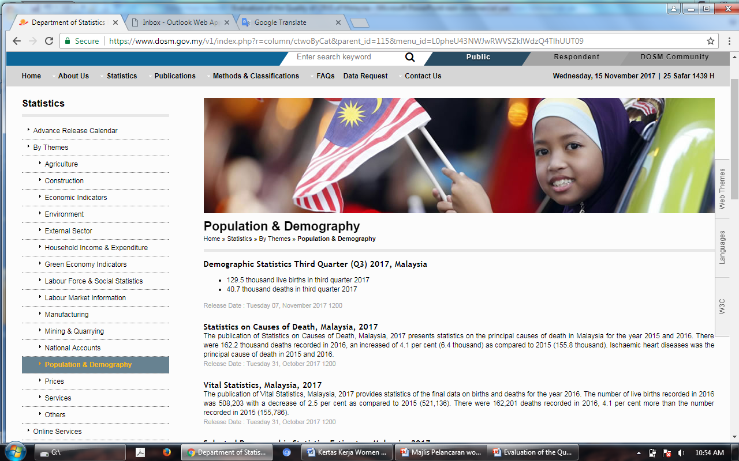
JABATAN PERANGKAAN MALAYSIA
https://www.dosm.gov.my
https://www.facebook.com/StatsMalaysia
https://twitter.com/StatsMalaysia

Slide 12
Link to the publication in our portal
https://www.dosm.gov.my/v1/index.php?r=column/cthemeByCat&cat=430&bul_id=MFpnNGw4RnZmRnNKeC80Q25DZUgzZz09&menu_id=L0pheU43NWJwRWVSZklWdzQ4TlhUUT09
Quarterly Demographics Statistics
https://www.dosm.gov.my/v1/index.php?r=column/cthemeByCat&cat=165&bul_id=NXRCRDh0RENGeU13bC9EdzJ1cUFtZz09&menu_id=L0pheU43NWJwRWVSZklWdzQ4TlhUUT09
Vital Statistics, Malaysia 2017
https://www.dosm.gov.my/v1/index.php?r=column/cthemeByCat&cat=401&bul_id=Y3psYUI2VjU0ZzRhZU1kcVFMMThGUT09&menu_id=L0pheU43NWJwRWVSZklWdzQ4TlhUUT09
Statistics on Causes of Death, Malaysia 2017
JABATAN PERANGKAAN MALAYSIA
https://www.dosm.gov.my
https://www.facebook.com/StatsMalaysia
https://twitter.com/StatsMalaysia

Slide 13




Thank you
Terima kasih
www.dosm.gov.my
StatsMalaysia

